Slide 1


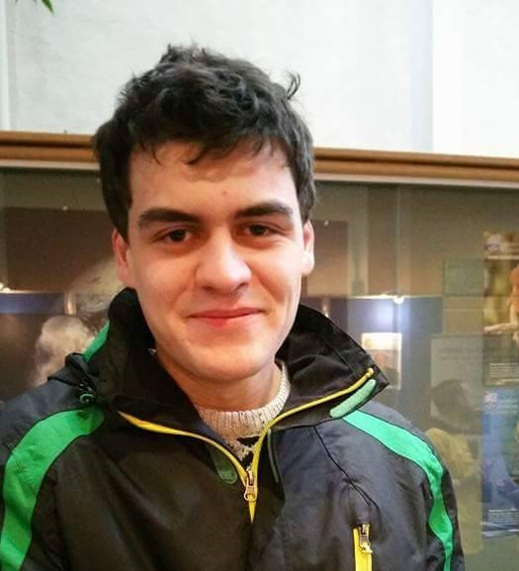

Throughout this TEDd talk ‘Bits Please’ will explore the various contributions that war has made to the development of computing throughout the ages. They will explore the social necessities that drive technological innovation during periods of war. They will explore the direct and indirect contributions that war has made towards modern computing technologies now used in our everyday lives.
Brandon Dooley (Team Leader)
Owen Duffy
(Co-Speaker)
Eoin Dowling
(Q&A Panel)
Paul Devaney
(Q&A Panel)

